Slide 1



UNIVERSITY OF BUEA
FACULTY OF ENGINEERING AND TECHNOLOGY
DEPARTMENT OF COMPUTER ENGINEERING
DESIGN AND IMPLEMENTATION OF A PROPOSED EMPLOYEE ATTENDANCE MANAGEMENT SYSTEM
Presented By
QUINUEL TABOT NDIP-AGBOR
MATRICULE: FE21A300
OPTION: SOFTWARE ENGINEERING
1

Slide 2




OUTLINE
1. INTRODUCTION
2. INTERNSHIP ACTIVITIES
3. EXTRA-CURRICULAR ACTIVITIES
4. DIFFICULTIES AND CHALLENGES
5. CONCLUSION
6. REFERENCES
2

Slide 3


1.INTRODUCTION
Goals of My Internship Journey
1. Applying theoretical knowledge from my coursework at the Faculty of Engineering and Technology
2. Gaining hands-on experience and building my network
3. Learning new technologies
4. Gaining industry insights
5. Enhancing my problem-solving and critical-thinking skills
3

Slide 4



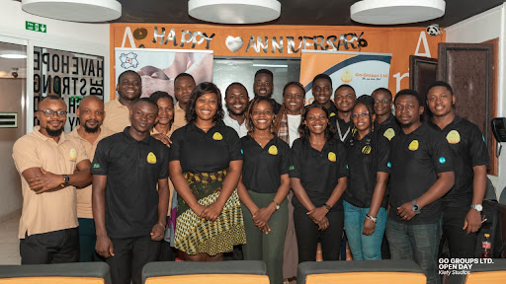



1.INTRODUCTION (CONT.)
Presentation Of The Company:
GO-GROUPS LIMITED
Go-Groups LTD is a software company based in Buea, Cameroon envisioned to advance the use of computer technology in the face of scarce resources with the motto “Be on the GO”.
It was founded in 2012 and provides Software as a Service (SaaS).
Go-Groups Ltd has built on applications in different sectors such as Go-Student, GoJobs, GoWaka, and couple of others.
4

Slide 5
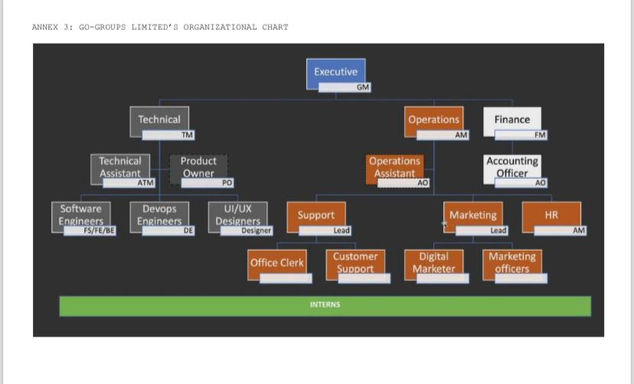

GO-GROUPS LTD’S ORGANISATIONAL CHART
5

Slide 6


2. INTERNSHIP ACTIVITIES
Professional Supervisors
My technical supervisor Engr. Mantoh Nasah and Engr. Cyprian Tingiweh are graduates of the University of Buea, played a vital role in my internship.
Their software development expertise strong work ethic and dedication enabled them to provide comprehensive guidance, mentor me effectively, and ensure my successful learning experience.
Industrial Supervisors
6

Slide 7
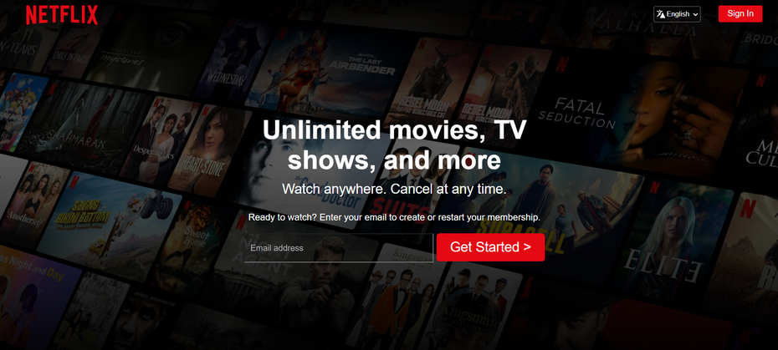
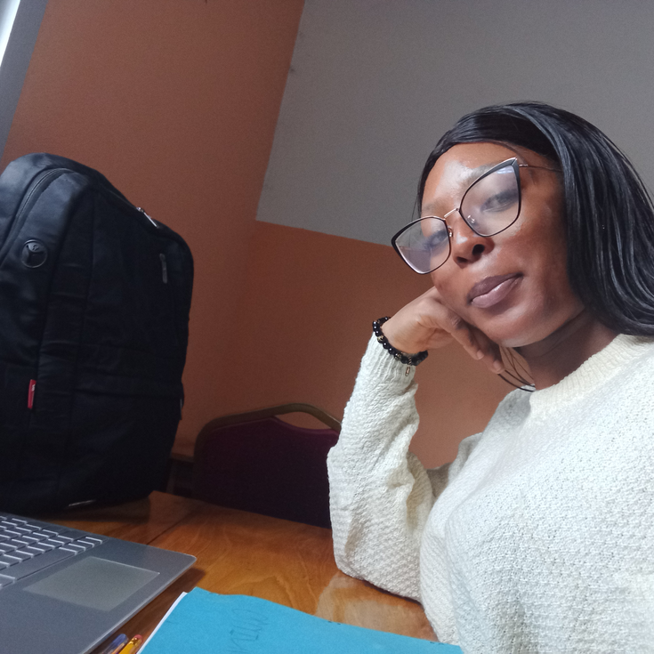
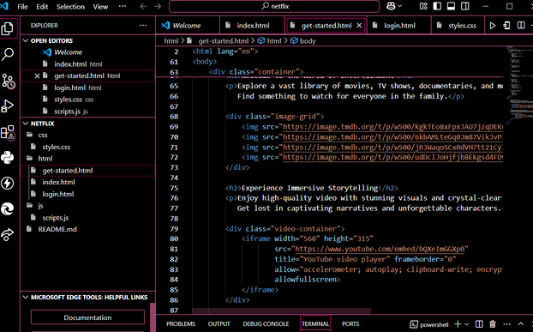
2. INTERNSHIP ACTIVITIES (CONT.)
First Day and First Week Experience
My internship started with team introductions and company familiarization, followed by a task to replicate the Netflix landing page using HTML, CSS and Javascript.
This project improved my technical skills and introduced me to professional standards.
The orientation provided a strong foundation, clarifying my responsibilities and enabling effective contributions.
Week 1
Day 1
7

Slide 8


2. INTERNSHIP ACTIVITIES (CONT.)
What’s the problem?
INTERNSHIP PROJECT
Problem Statement
Before implementing this employee attendance management system, Go-Groups Ltd faced numerous obstacles in managing employee attendance.
Manual processes were inefficient, error-prone, and hindered data analysis.
Attendance statistics influence payroll accuracy, cost control and even performance evaluation.
Exhausting 🤦🏽‍♂️
Prone to errors ✍🏽
8

Slide 9
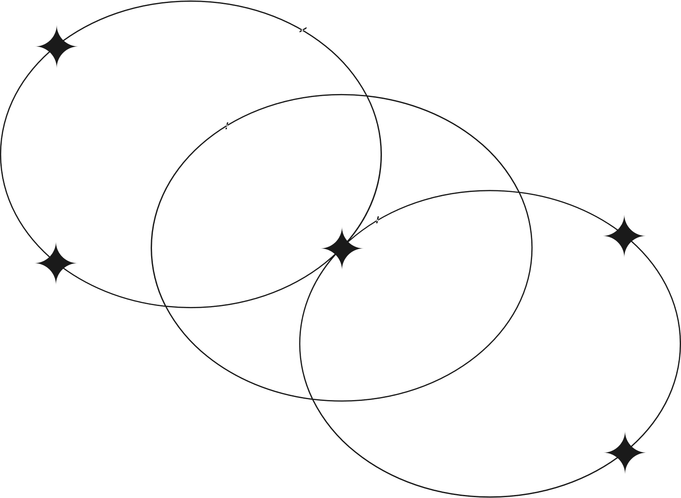
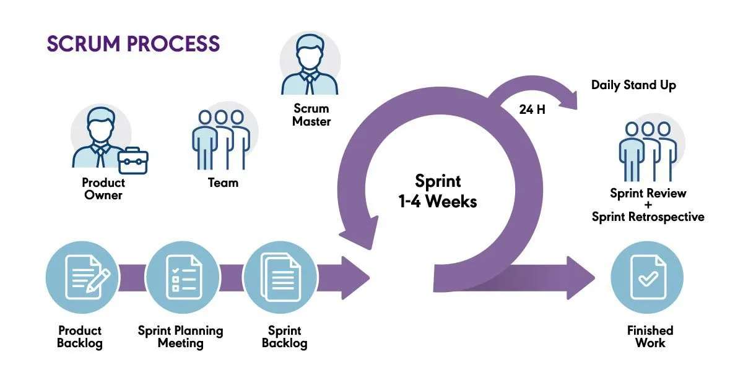
2. INTERNSHIP ACTIVITIES (CONT.)
Methodology
9

Slide 10
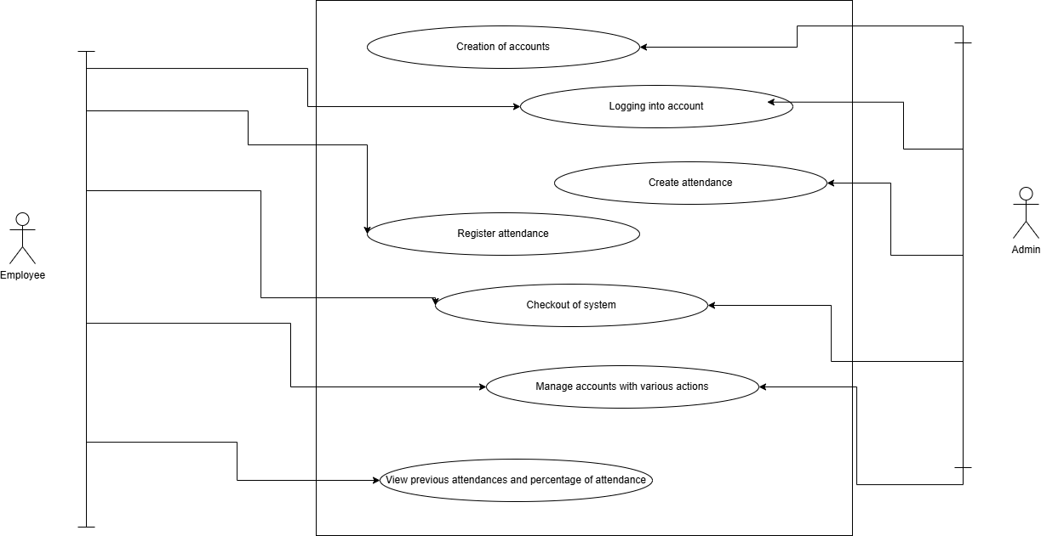
SYSTEM DESIGN: USE CASE DIAGRAM
10

Slide 11
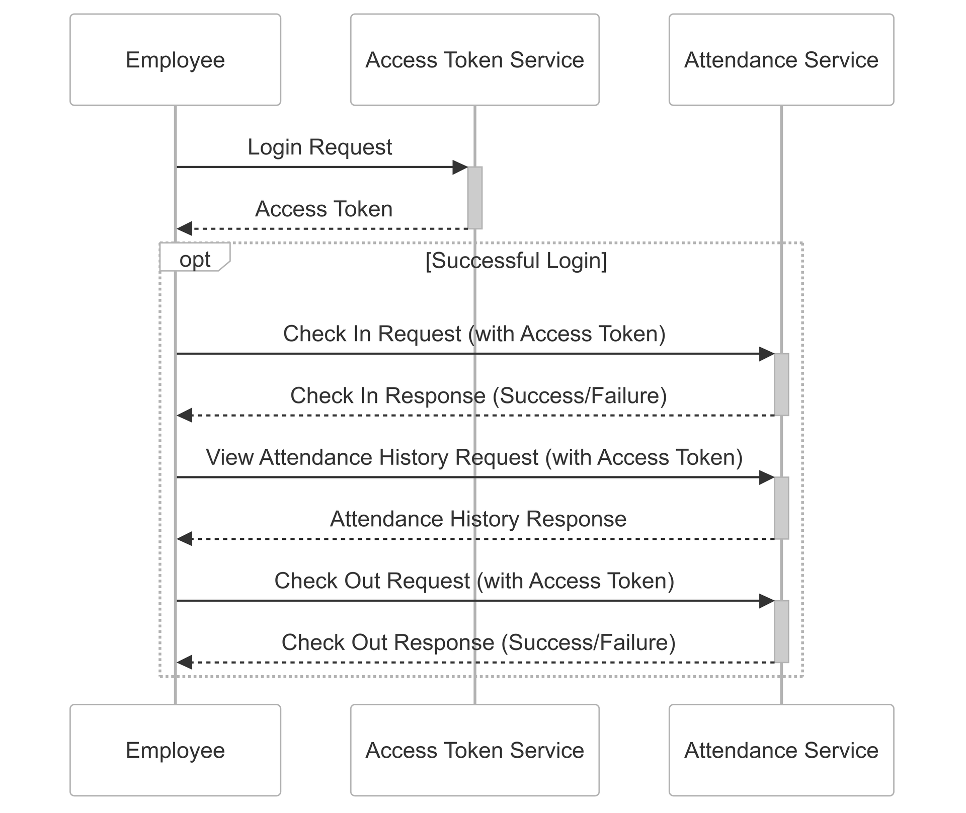
SEQUENCE DIAGRAM
11

Slide 12
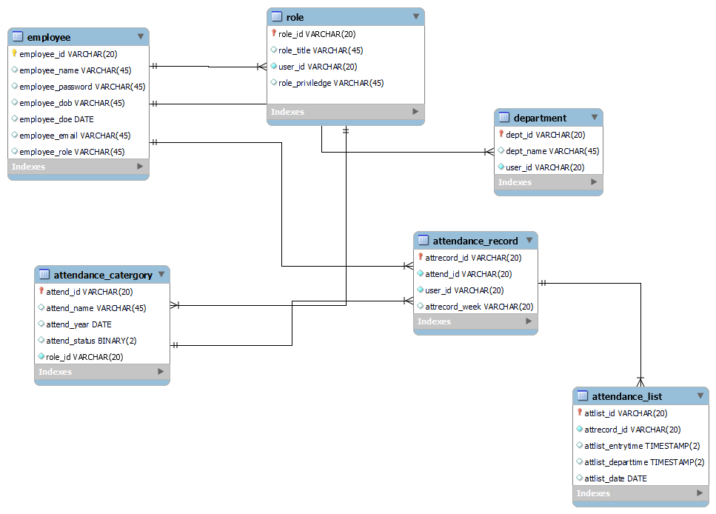
ENTITY RELATIONSHIP DIAGRAM
12

Slide 13
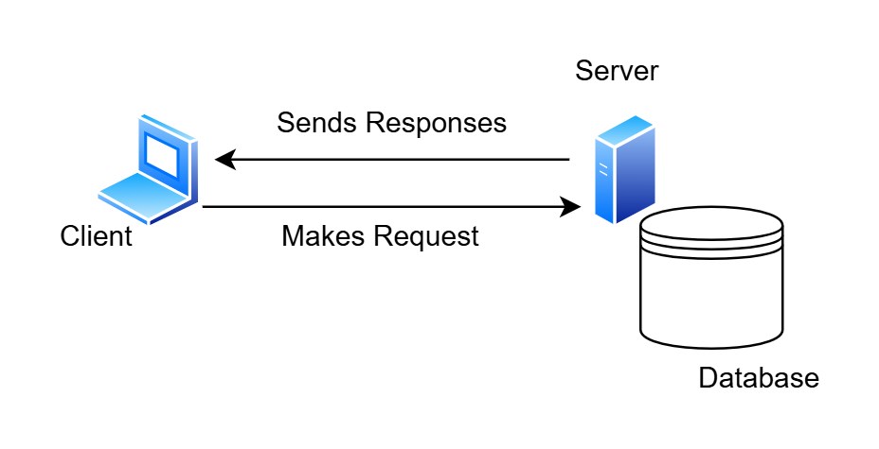
DEPLOYMENT DIAGRAM
13

Slide 14





2. INTERNSHIP ACTIVITIES (CONT.)
IMPLEMENTATION: Tools Used During Internship And For The Project
Being an onsite intern with an HP Laptop using the Ubuntu OS under the software development team assigned to full-stack development tasks, these were the following technologies used within the company and for this project:
Figma
Used for UI drafting
Angular Framework
HTML, CSS and Typescript
Spring Boot
Java Framework
MySQL
SQL Database
Git, GitHub
Version Control System
14

Slide 15

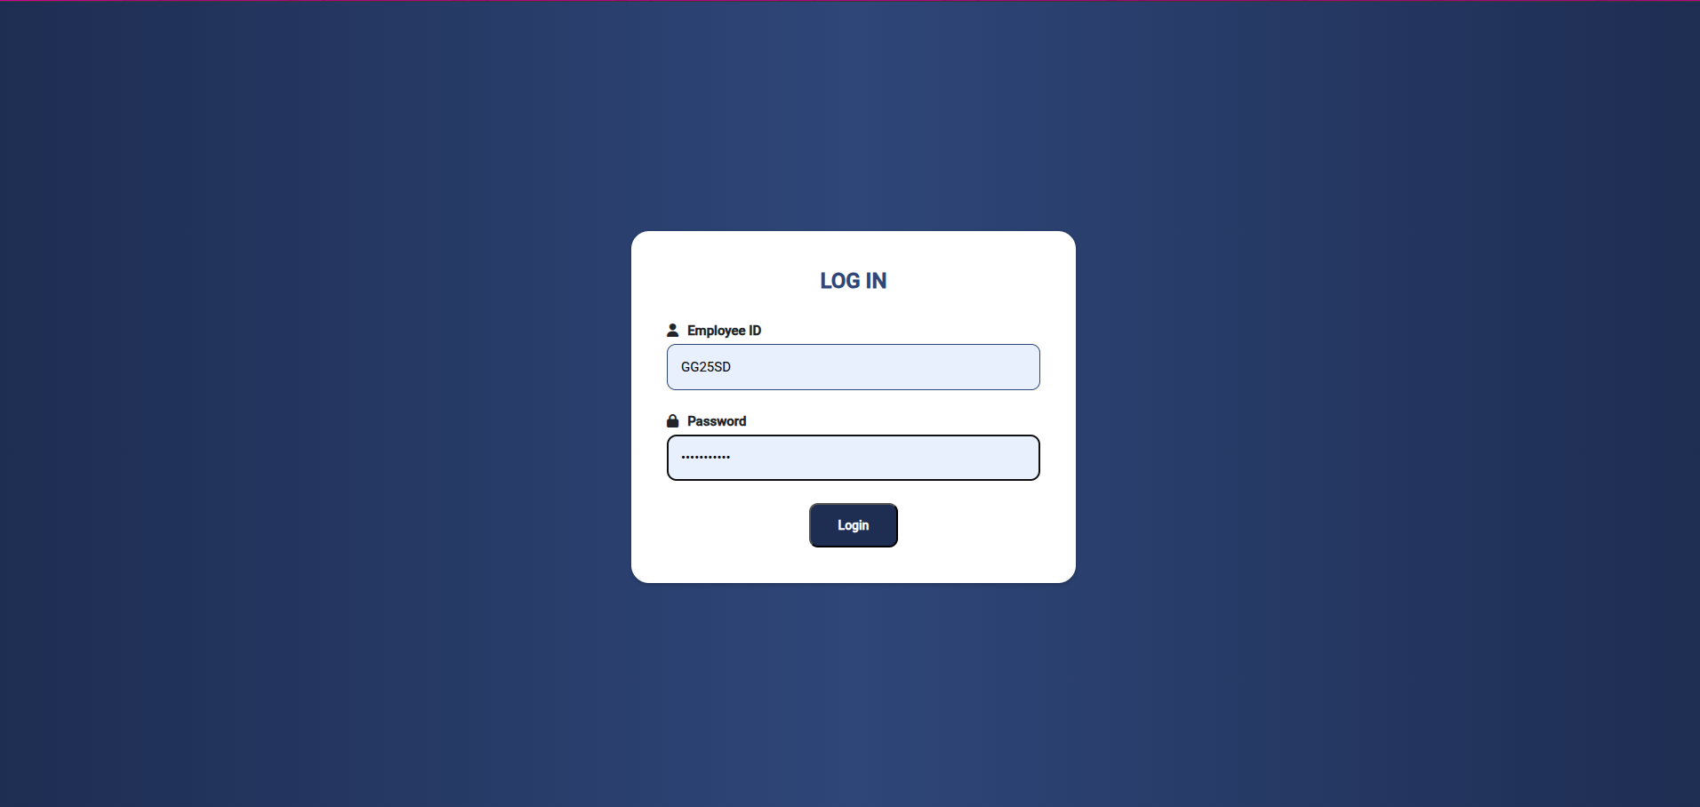
PRESENTATION OF IMPLEMENTATION
15

Slide 16
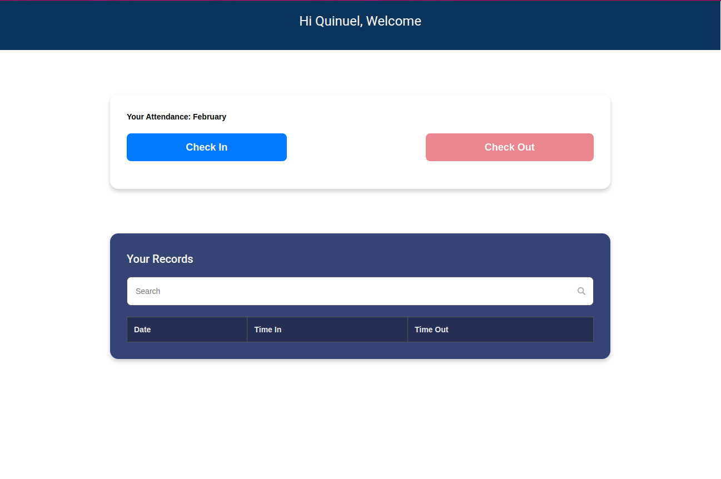
PRESENTATION OF IMPLEMENTATION
16

Slide 17
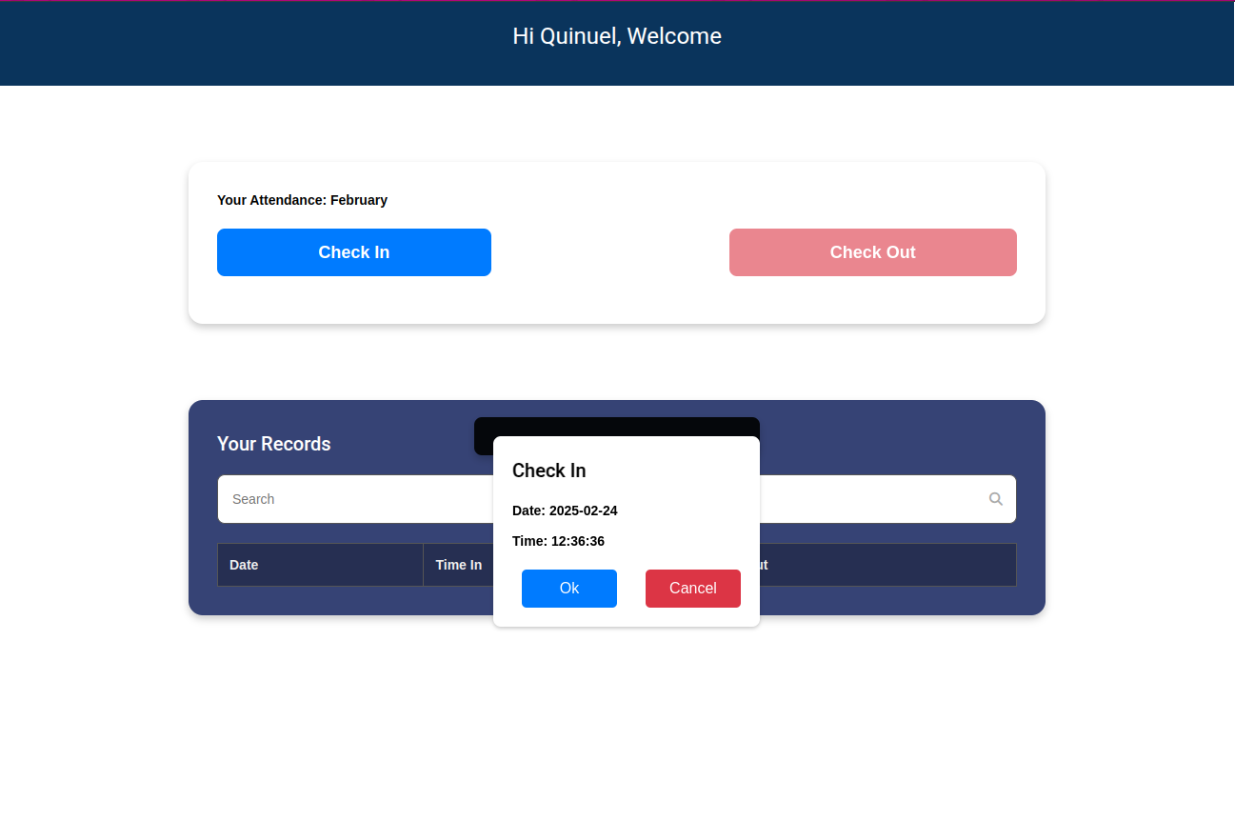
PRESENTATION OF IMPLEMENTATION
17

Slide 18
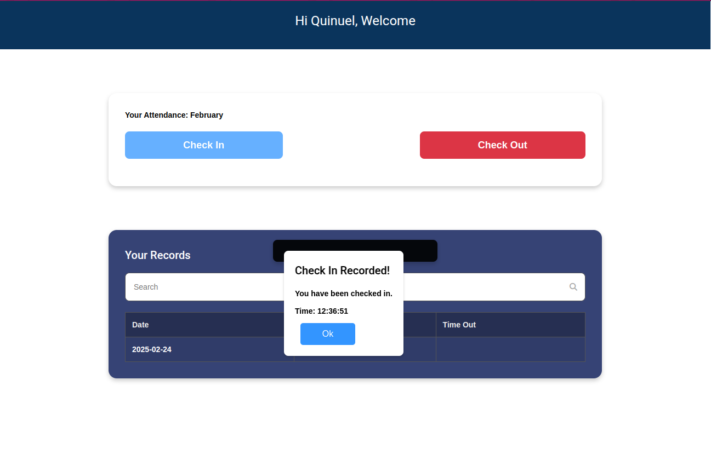
PRESENTATION OF IMPLEMENTATION
GO EMS
18

Slide 19
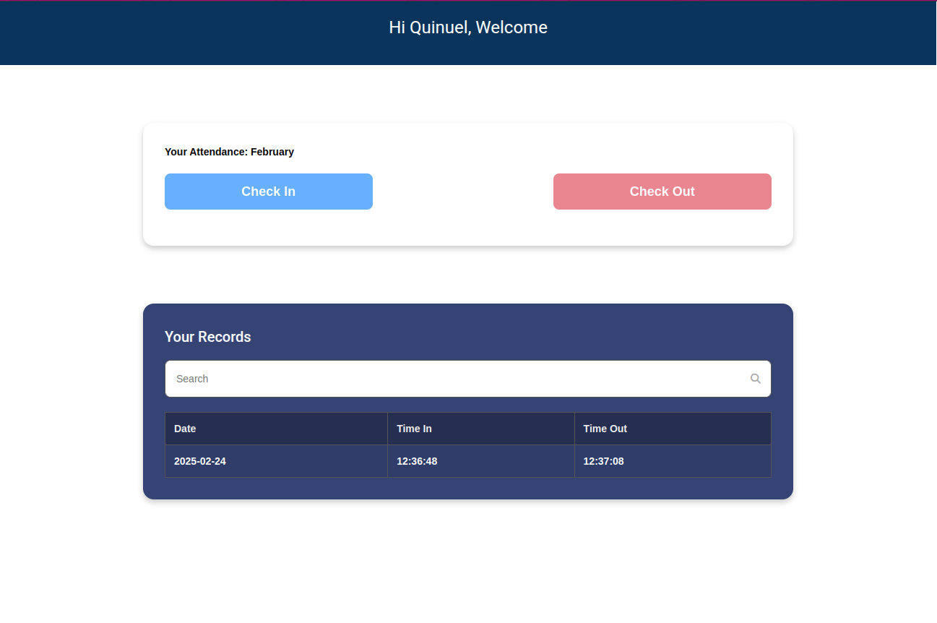
PRESENTATION OF IMPLEMENTATION
19

Slide 20
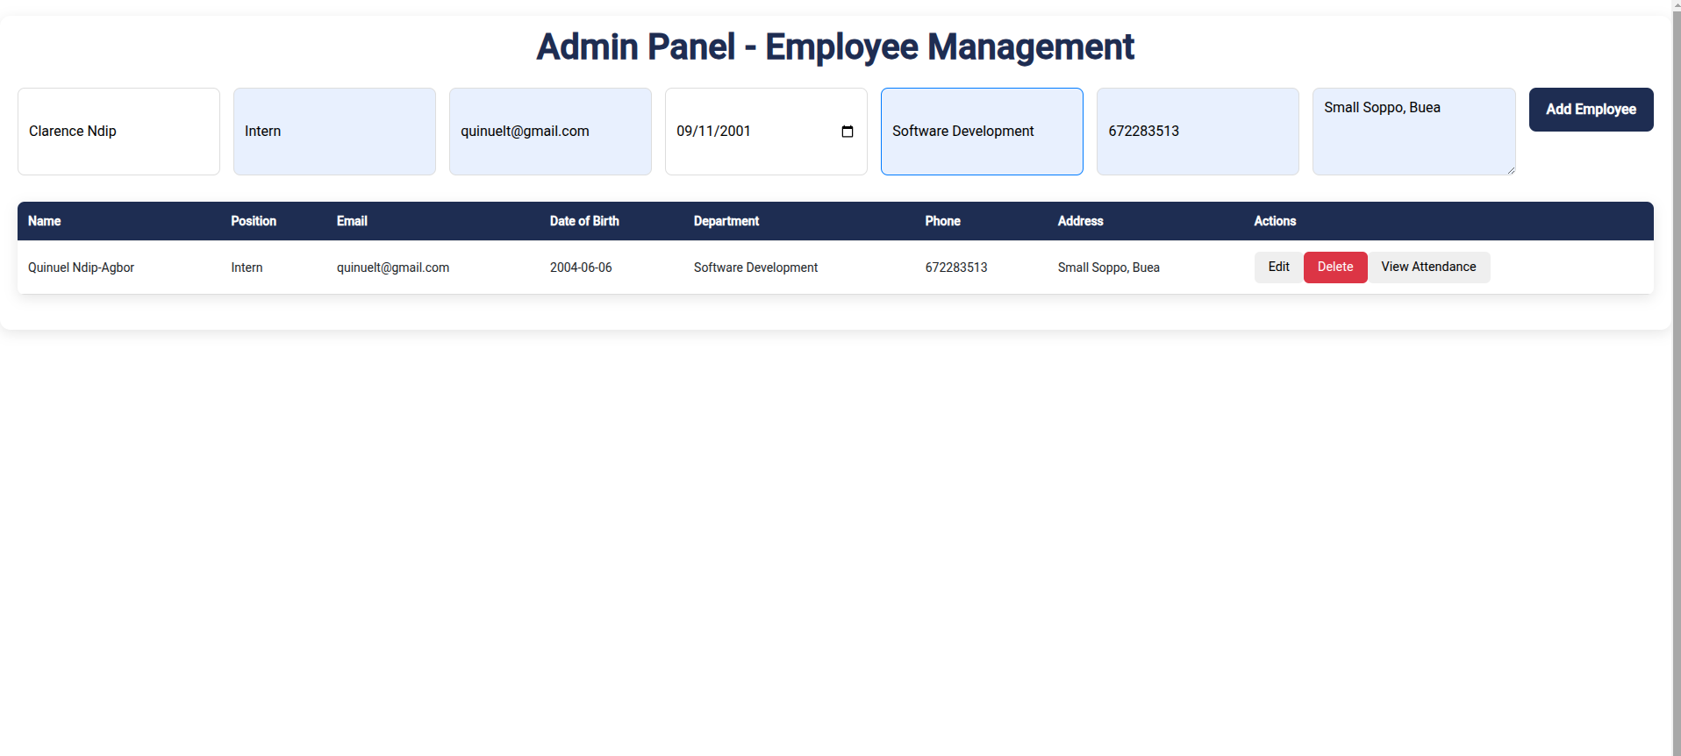
PRESENTATION OF IMPLEMENTATION
20

Slide 21
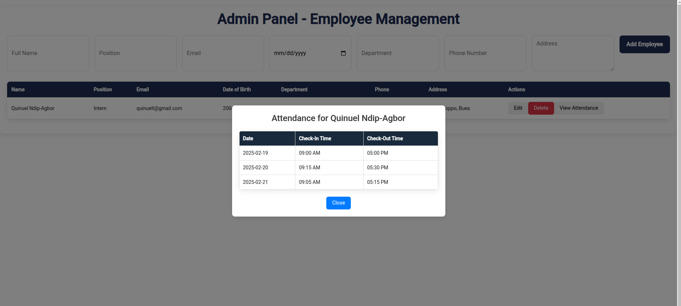
PRESENTATION OF IMPLEMENTATION
21

Slide 22
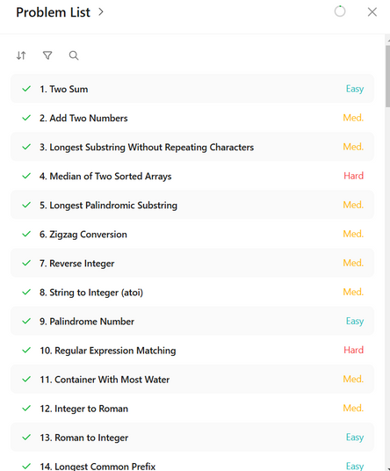
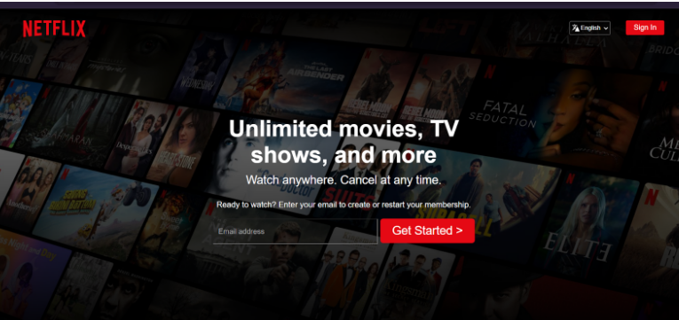
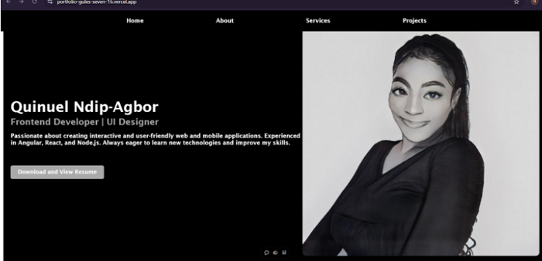
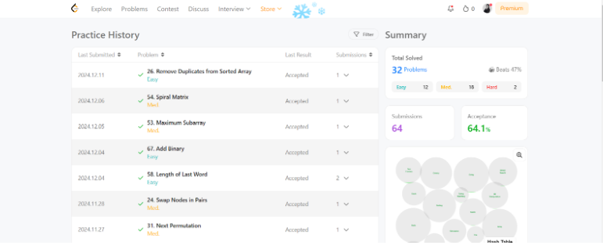
2. INTERNSHIP ACTIVITIES (CONT.)
More Learning Projects And Tasks
REPLICATION OF NETFLIX HOME SCREEN WITH HTML, CSS AND JS
HACKERRANK TYPESCRIPT CHALLENGES
LEETCODE JAVA CHALLENGES
PERSONAL PORTFOLIO WITH ANGULAR
22

Slide 23
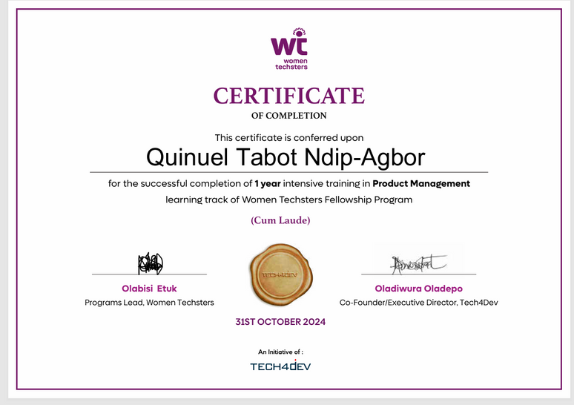
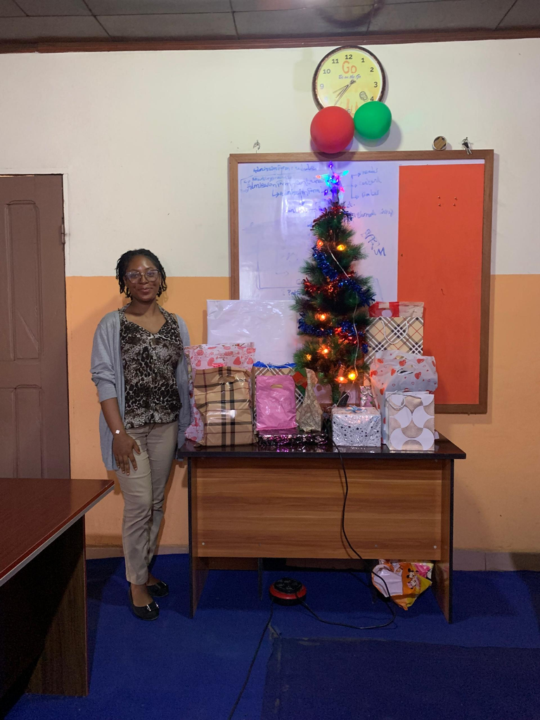
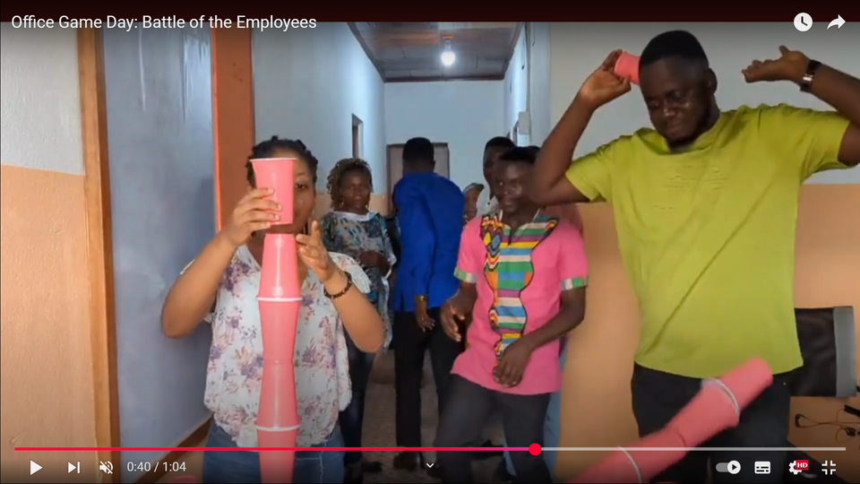
3. EXTRACURRICULAR ACTIVITIES
Women Techsters Program Completion
Christmas Party At The Office
Content Creation with Marketing Team for the Youtube Channel
23

Slide 24
4. DIFFICULTIES AND CHALLENGES
Adapting to Ubuntu
Meeting Deadlines
Debugging Codes
24

Slide 25

5. CONCLUSION
Insightful
Wonderful
Productive
25

Slide 26

6. REFERENCES
[1] Angular Team. (2023). Angular documentation.
Retrieved from https://angular.io/
[2] VMware. (2022). Spring Boot documentation.
Retrieved from https://spring.io/projects/spring-boot/
[3] Oracle Corporation. (n.d.). Oracle Java documentation.
Retrieved from https://docs.oracle.com/en/java/
[4] GitHub. (2022). GitHub docs. https://docs.github.com/
[5] Mozilla. (2019). CSS: Cascading Style Sheets. MDN Web Docs. https://developer.mozilla.org/en-US/docs/Web/CSS
[6] Beck, K., Beedle, M., van Benedum, A., Cockburn, A., Cunningham, W., Fowler, M., & Thomas, D. (2001). Manifesto for agile software development.
Retrieved from https://agilemanifesto.org/
[7] Schwaber, K., & Sutherland, J. (2020). The scrum guide
Retrieved from https://scrumguides.org/
[8] Stack Overflow. (n.d.). Stack Overflow. https://stackoverflow.com/
[9] W3Schools. (n.d.). W3Schools. https://www.w3schools.com/
[10] Google. (2024). Gemini. https://gemini.google.com/app
[11] Freepik. (2020). Freepik. https://www.freepik.com/
26

Slide 27
Thank you for your attention
THE END
27

